Slide 1

Java With IntelliJ
Conditional
Statement Part 1I
Else If Statement

Slide 2
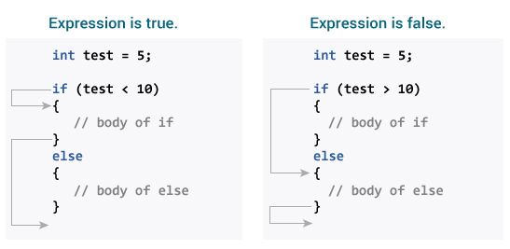
We learned that…
Conditional statement is a statement that happens as a result of something that happened
You implement if else statement by
If(//condition that you want to control)
Else //if the statement is false

Slide 3

Else If
If Else statement itself is not enough
You are limited to two conditions
What if you want more than two conditions?
That’s where the Else If statement comes into play

Slide 4
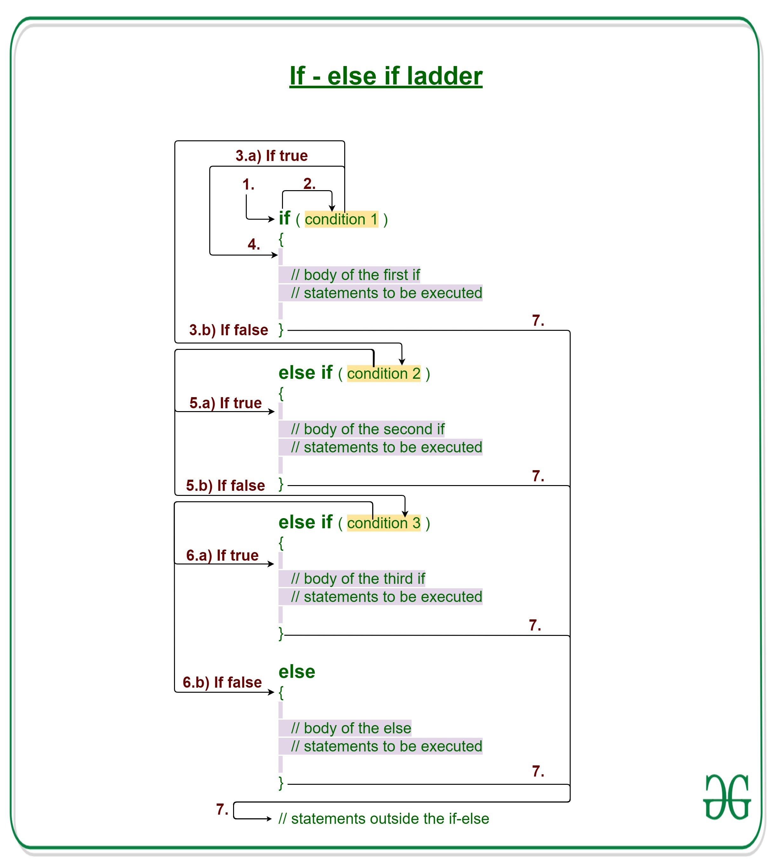
How To Implement The Else If Statement
So you must put in the Else If statement in between the if statement and else statement
else if (//what other condition if the if statement is false)

